Slide 1
Cornerstone City Church Peninsula Plus Community Hoo Are Ya
2nd November 2025

Slide 2


Slide 3
Thanksgiving
CCLI Song # 7199589
Nick Herbert | Taku Mudere | Zo Chilengwe
© Capitol CMG Genesis; Safe and Sound Music; Remaining portion is unaffiliated
For use solely with the SongSelect® Terms of Use. All rights reserved. www.ccli.com
CCLI Licence No. 33265

Slide 4
1/10
Enter in (Enter in)
His courts with praise (His courts with praise)
For He is greatly (He is greatly)
To be praised (To be praised)

Slide 5
2/10
Enter in (Enter in)
His courts with praise (His courts with praise)
For He is greatly (He is greatly)
To be praised

Slide 6
3/10
What shall we do
We shall lift up a shout
What shall we do
We shall praise Him
What shall we do
For our God made a way
We'll give Him our thanksgiving

Slide 7
4/10
Magnify (Magnify)
His Holy Name (His Holy Name)
For He is greatly (For He is greatly)
To be praised (To be praised)

Slide 8
5/10
Magnify (Magnify)
His Holy Name (His Holy Name)
For He is greatly (For He is greatly)
To be praised

Slide 9
6/10
What shall we do
We shall lift up a shout
What shall we do
We shall praise Him
What shall we do
For our God made a way
We'll give Him our thanksgiving

Slide 10
7/10
Even if the rocks cry out
We're gonna drown them out
With a louder shout of praise
Even when the battles roar
We're gonna praise You Lord
'Cause You are always worthy

Slide 11
8/10
You are worthy
Worthy of honour and praise
You are worthy
We'll sing it again and again

Slide 12
9/10
What shall we do
We shall lift up a shout
What shall we do
We shall praise Him
What shall we do
For our God made a way
We'll give Him our thanksgiving

Slide 13
10/10
We'll give Him our thanksgiving
We'll give Him our thanksgiving

Slide 14
Heart Of Worship CCLI Song # 2296522
Matt Redman
© 1997 Thankyou Music (Admin. by Integrity Music Ltd)
For use solely with the SongSelect® Terms of Use. All rights reserved. www.ccli.com
CCLI Licence No. 33265

Slide 15
1/6
When the music fades all is stripped away
And I simply come
Longing just to bring something that's of worth
That will bless Your heart

Slide 16
2/6
I'll bring You more than a song
For a song in itself is not what You have required
You search much deeper within
Through the way things appear
You're looking into my heart

Slide 17
3/6
I'm coming back to the heart of worship
And it's all about You all about You Jesus
I'm sorry Lord for the thing I've made it
When it's all about You all about You Jesus

Slide 18
4/6
King of endless worth no one could express
How much You deserve
Though I'm weak and poor all I have is Yours
Ev'ry single breath

Slide 19
5/6
I'll bring You more than a song
For a song in itself is not what You have required
You search much deeper within
Through the way things appear
You're looking into my heart

Slide 20
6/6
I'm coming back to the heart of worship
And it's all about You all about You Jesus
I'm sorry Lord for the thing I've made it
When it's all about You all about You Jesus

Slide 22
Open The Eyes of My Heart
CCLI Song # 2298355
Paul Baloche
© 1997 Integrity's Hosanna! Music (Admin. by Integrity Music Ltd)
For use solely with the SongSelect® Terms of Use. All rights reserved. www.ccli.com
CCLI Licence No. 33265

Slide 23
1/3
Open the eyes of my heart Lord
Open the eyes of my heart
I want to see You
I want to see You

Slide 24
2/3
To see You high and lifted up
Shining in the light of Your glory
Pour out Your power and love
As we sing holy holy holy

Slide 25
3/3
Holy holy holy
Holy holy holy
Holy holy holy
I want to see You

Slide 27
Worthy
CCLI Song # 7111931
Chris Brown | Mack Brock | Steven Furtick
© Music by Elevation Worship Publishing (Admin. by Essential Music Publishing LLC)
For use solely with the SongSelect® Terms of Use. All rights reserved. www.ccli.com
CCLI Licence No. 33265

Slide 28
1/6
It was my cross You bore
So I could live in the freedom You died for
And now my life is Yours
And I will sing of Your goodness forevermore

Slide 29
2/6
Worthy is Your name, Jesus
You deserve the praise
Worthy is Your name
Worthy is Your name, Jesus
You deserve the praise
Worthy is Your name

Slide 30
3/6
And now my shame is gone
I stand amazed in Your love undeniable
Your grace goes on and on
And I will sing of Your goodness forevermore

Slide 31
4/6
Worthy is Your name, Jesus
You deserve the praise
Worthy is Your name
Worthy is Your name, Jesus
You deserve the praise
Worthy is Your name (REPEAT)

Slide 32
5/6
Be exalted now in the heavens
As Your glory fills this place
You alone deserve our praise
You're the name above all names (REPEAT)

Slide 33
6/6
Worthy is Your name, Jesus
You deserve the praise
Worthy is Your name
Worthy is Your name, Jesus
You deserve the praise
Worthy is Your name

Slide 34
1/3
Death could not hold You The veil tore before You You silence the boast of sin and grave The heavens are roaring The praise of Your glory For You are raised to life again

Slide 35
2/3
You have no rival You have no equal Now and forever God You reign Yours is the kingdom Yours is the glory Yours is the Name above all names

Slide 36
3/3
What a powerful Name it is What a powerful Name it is The Name of Jesus Christ my King What a powerful Name it is Nothing can stand against What a powerful Name it is The Name of Jesus

Slide 37


Slide 38
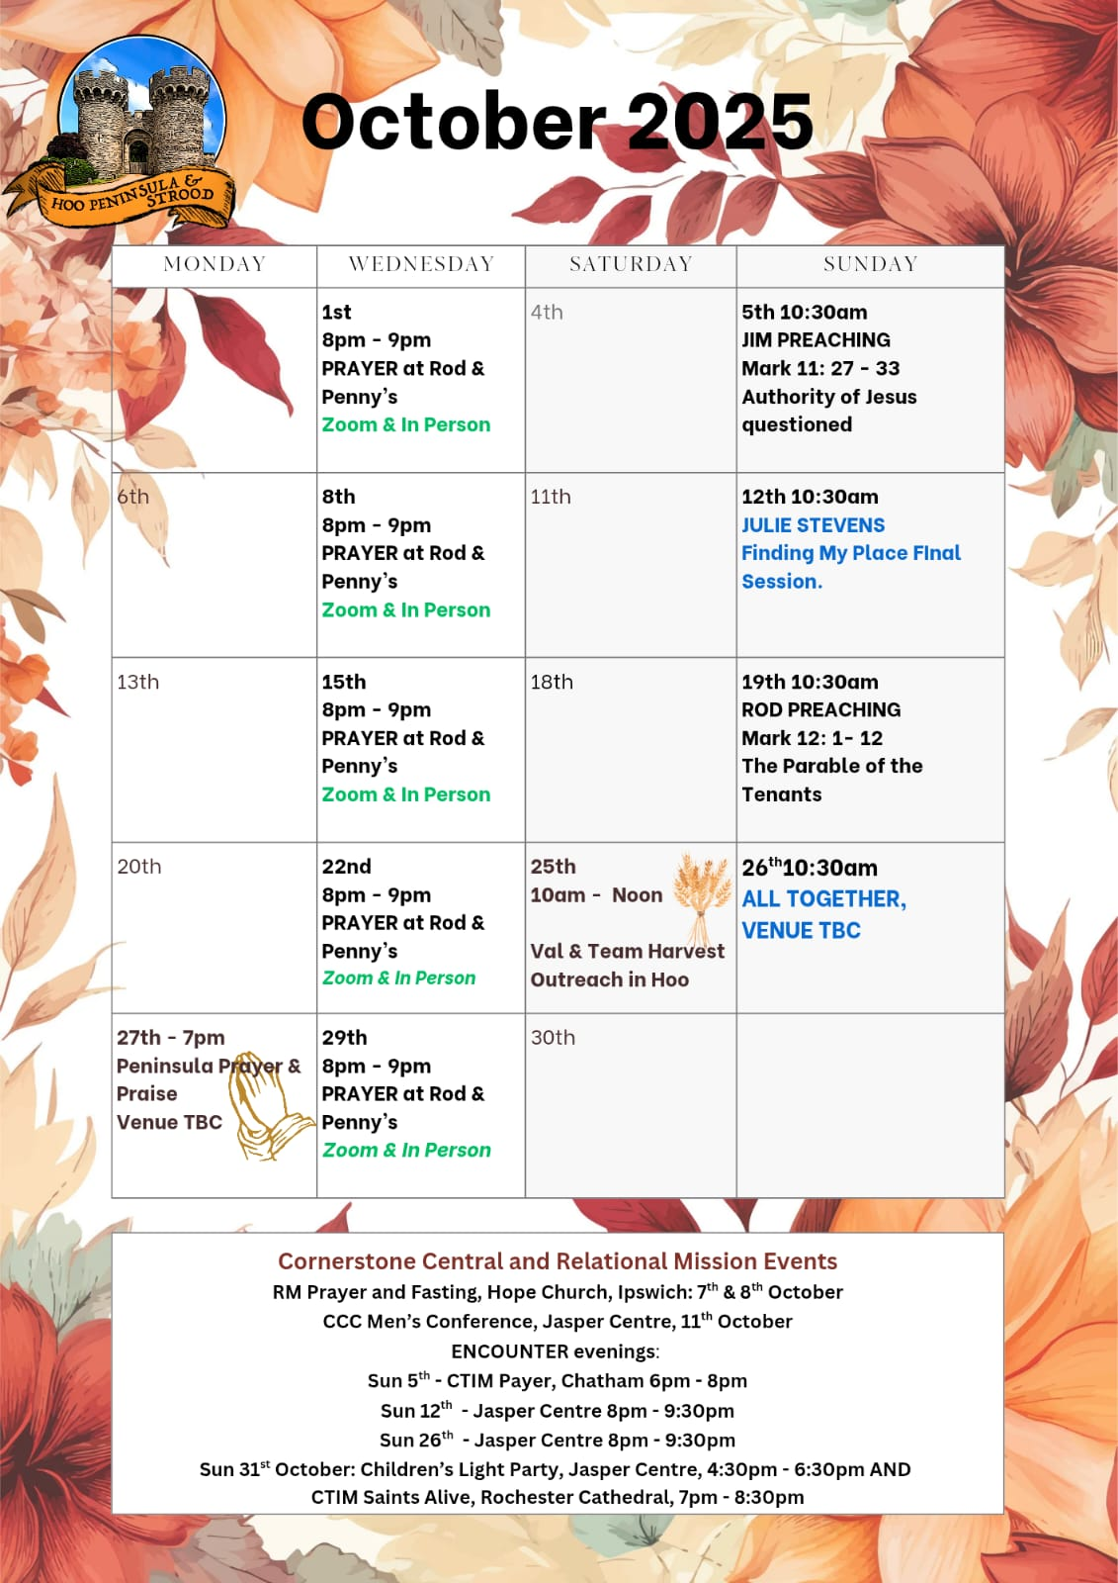

Slide 39
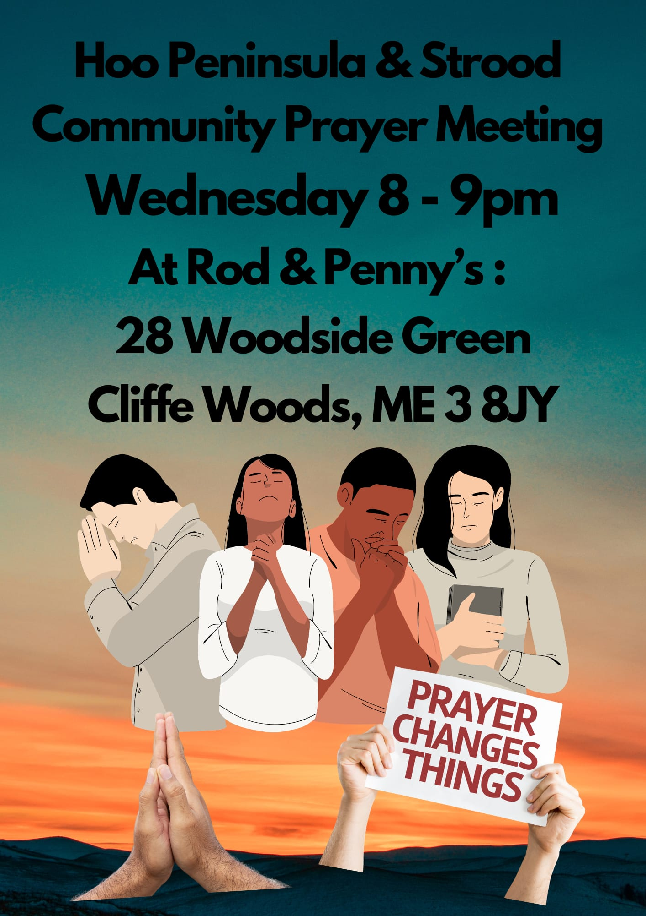

Slide 40


Slide 41


Slide 42
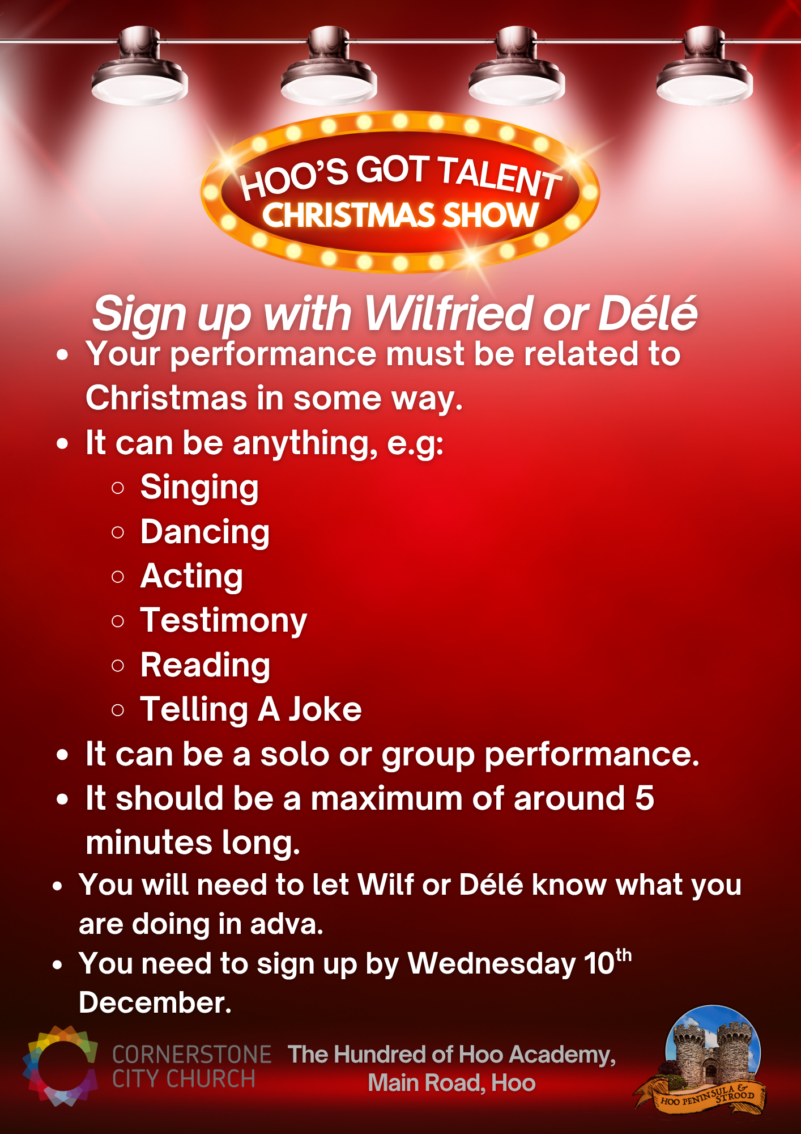

Slide 43

Grow Group 1
On YOUR MARK!

Slide 44
Leaders
Leaderss
Phil & Kim
Maria (Mia) Warren
Matthew Harrison
Richard & Elisha Acheampong
Phil & Kim
Maria (Mia) Warren
Matthew Harrison
Richard & Elisa Acheampong

Slide 45
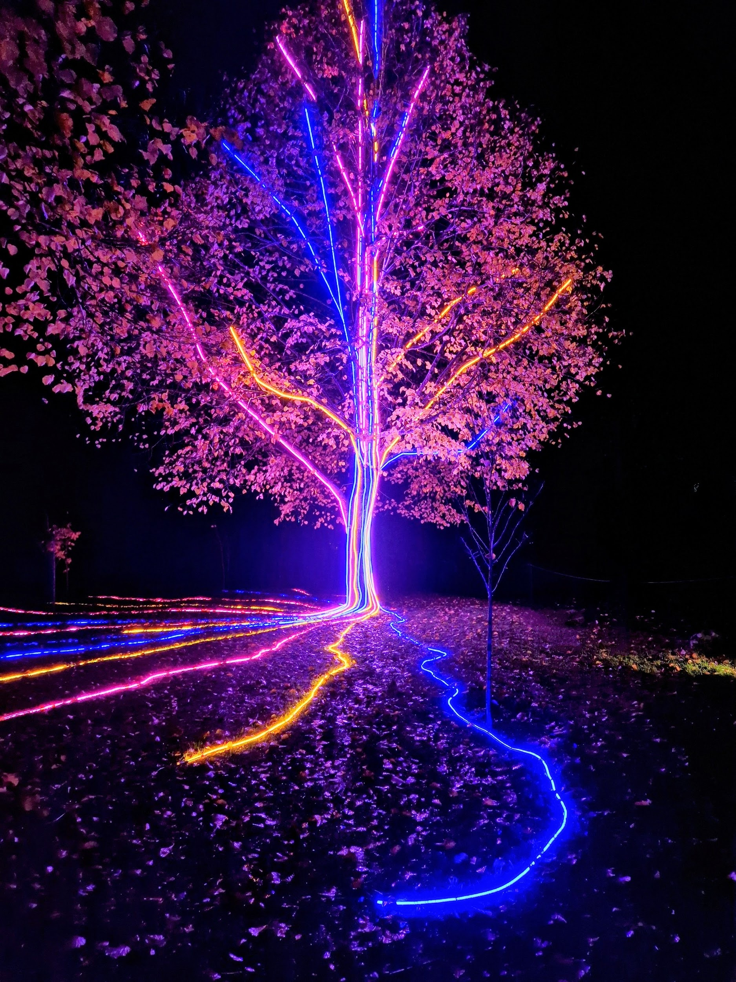
Storm Walker
Storm Walker
Symbolising, trust in Jesus Christ through life's storms.
Mark 4:35-41

Slide 46


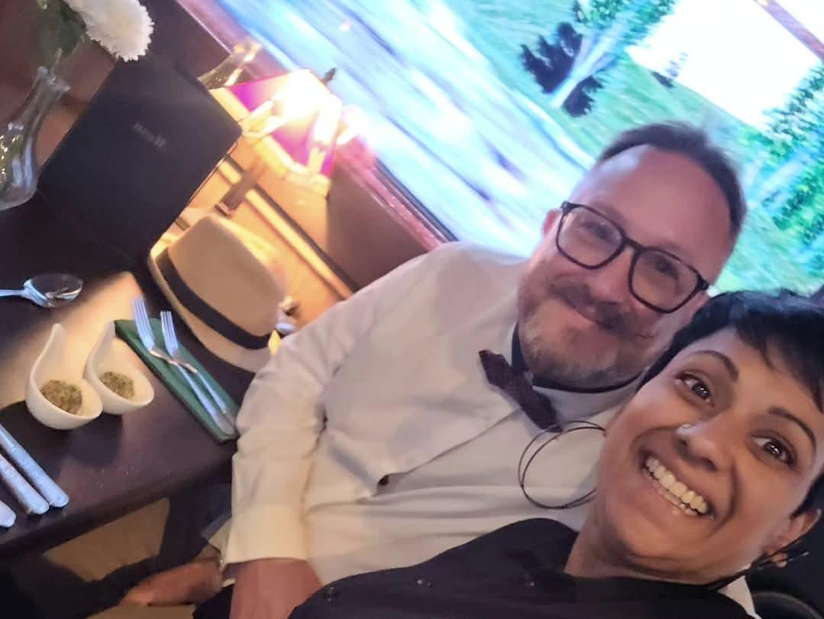
Group Leaders
Micheal and Mwamba
Wilfred and Parveen
Hannah

Slide 47


Slide 48


Slide 49


Slide 50
Great Are You Lord
CCLI Song # 6460220
David Leonard | Jason Ingram | Leslie Jordan
© 2012 Open Hands Music (Admin. by Essential Music Publishing LLC)
So Essential Tunes (Admin. by Essential Music Publishing LLC)
Integrity's Praise! Music (Admin. by Integrity Music Ltd)
Little Way Creative (Admin. by Integrity Music Ltd)
For use solely with the SongSelect® Terms of Use. All rights reserved. www.ccli.com
CCLI Licence No. 33265

Slide 51
1/3
You give life You are love
You bring light to the darkness
You give hope You restore ev'ry heart that is broken
And great are You Lord

Slide 52
2/3
It's Your breath in our lungs
So we pour out our praise
We pour out our praise
It's Your breath in our lungs
So we pour out our praise to You only

Slide 53
3/3
And all the earth will shout Your praise
Our hearts will cry these bones will sing
Great are You Lord
(REPEAT)

Slide 54
2 Corinthians 14 May the grace of the Lord Jesus Christ, and the love of God, and the fellowship of the Holy Spirit be with you all
Surely goodness and mercy shall follow us all the days of our lives, and we shall dwell in the house of the Lord forever.

